Slide 1
Digital Portfolio
STUDENT NAME: SAI TEJA S
REGISTER NO AND NMID:212402419/
0839AD74A1AB2FB99C942CE217AE5BFB
DEPARTMENT: BCA
COLLEGE: AGURCHAND MANMULL JAIN COLLEGE/university of madras

Slide 2
PROJECT TITLE
Digital Portfolio

Slide 3


AGENDA
PROBLEM STATEMENT
- Traditional paper resumes/portfolios are difficult to update and share.
- Lack of interactivity makes it less engaging for employers.
- Students and professionals need a modern, accessible way to showcase skills.
3/21/2024 Annual Review

Slide 4

PROBLEM STATEMENT
Traditional paper resumes/portfolios are difficult to update and share.
- Lack of interactivity makes it less engaging for employers.
- Students and professionals need a modern, accessible way to showcase skills.

Slide 5

PROJECT OVERVIEW
- A web-based digital portfolio platform.
- Showcases academic qualifications, projects, skills, and achievements. - Provides an organized, professional, and easily shareable online profile.

Slide 6

WHO ARE THE END USERS?
- Students
- Job Seekers
- Recruiters / Employers
- Educational Institutions

Slide 7

TOOLS AND TECHNOLOGIES
- HTML, CSS, JavaScript
- Bootstrap / Tailwind CSS
- PHP / Python (Flask/Django)
- MySQL / MongoDB
- GitHub Pages / Netlify (for hosting)

Slide 8
PORTFOLIO DESIGN AND LAYOUT
- Responsive, mobile-friendly design.
- Homepage with personal info and summary.
- Sections: About, Education, Skills, Projects, Achievements, Contact.
- Clean typography and consistent color scheme.
8

Slide 9
FEATURES AND FUNCTIONALITY
- Interactive and user-friendly interface.
- Upload projects with images and GitHub links.
- Contact form integration.
- Easy customization of themes/layouts.
- Secure login for editing/updating portfolio.

Slide 10
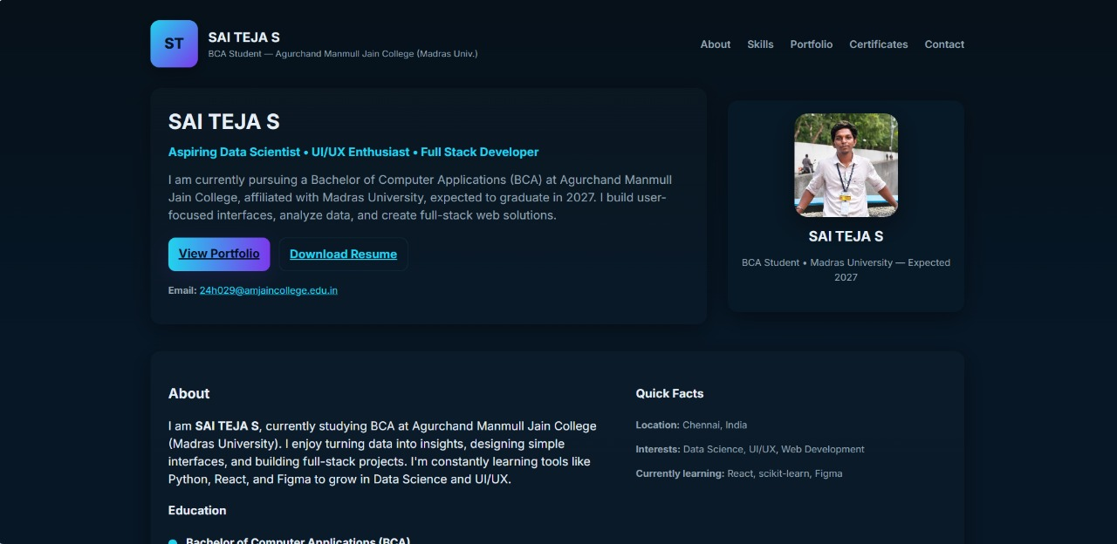

RESULTS AND SCREENSHOTS
- Successfully deployed digital portfolio online.
- Faster and professional presentation of skills
https://github.com/SAITEJAS19/TNSDC-FWD-DP9.git
3/21/2024 Annual Review
10

Slide 11
CONCLUSION
- Digital portfolio provides a modern alternative to traditional resumes.
- Enhances visibility and accessibility for job seekers.
- Future scope: AI-based skill suggestions and analytics.
11

Slide 12
GITHUB LINK:https://saitejas19.github.io/TNSDC-FWD-DP9/

